Slide 1




2nd Quarter Program Implementation Review
School Logo

Slide 2
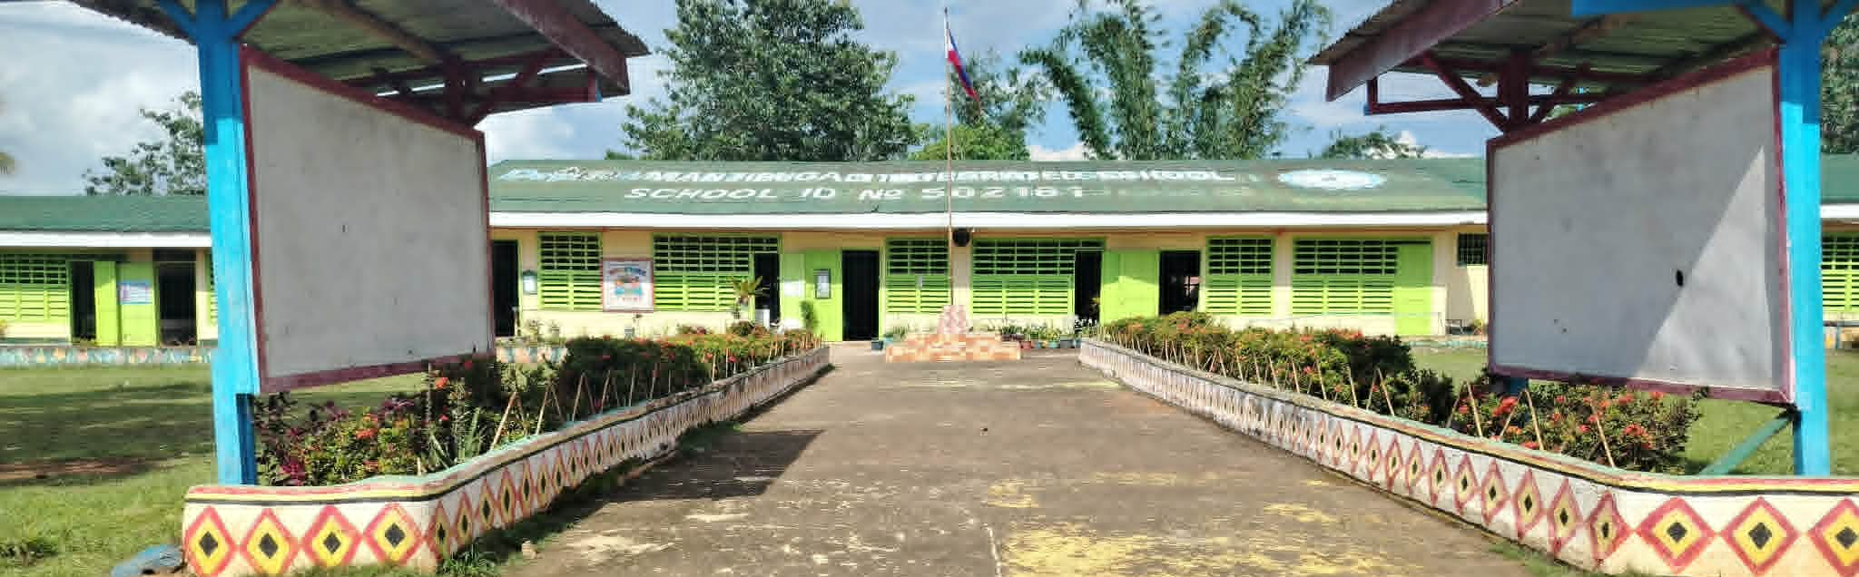
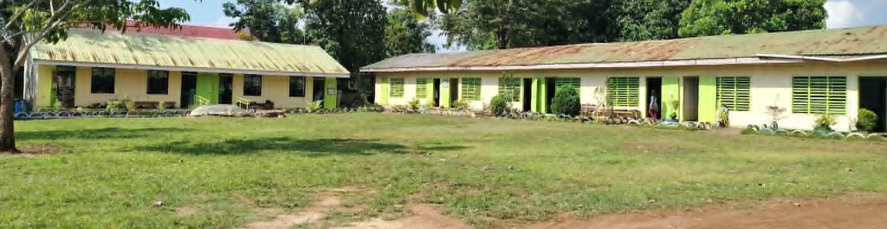
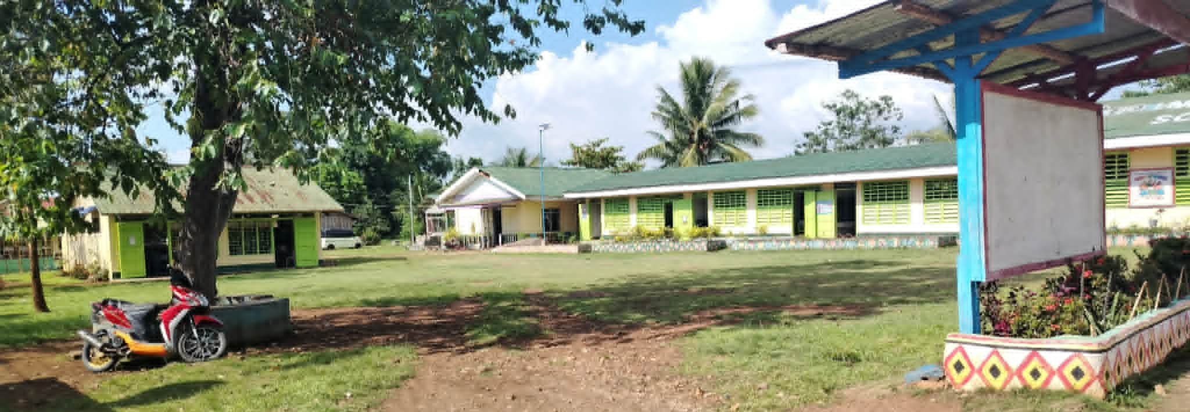
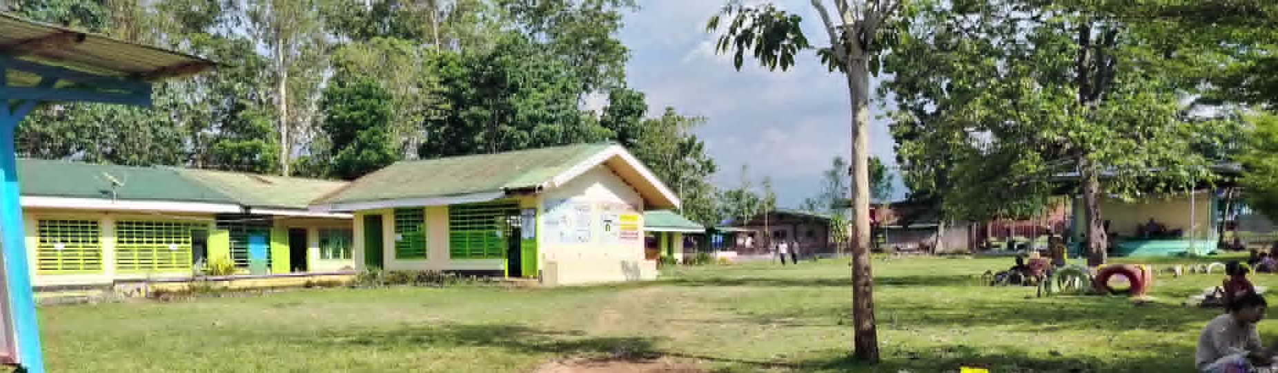
School Name: Mantibugao Integrated School
School ID: 502161
Region: Region X-Northern Mindanao
Division: Bukidnon
District: Manolo Fortich II
School Head: Myrna C. Vallente
Principal I
School Address: Zone-3, Mantibugao, Manolo Fortich, Bukidnon
Year Established: 1954
SCHOOL PROFILE
No. of Learners Enrolled | 711
No. of Teachers | 20
Learner-teacher Ratio | 36:1
No. of Classrooms | 14
No. of Makeshift | 4
Classroom-learner Ratio | 1:36

Slide 3
Performance Dashboard & Targets-Enrollment
Enrollment Indicator | SY 2024–2025 | SY 2025–2026 | Target SY 2026–2027 | Target SY 2027–2028
Total Enrollment | 731 | 733 | 711 | 800
Participation Rate | 91.34% | 92.11% | 97% | 100%
Community Intake Rate | 97% | 96% | 98% | 100%
Transition Rate | 94 | 97 | 100 | 100
School Leaver Rate | 4% | 5.59% | 0 | 0
Dropout Rate | 2.05% | 1.46% | 0 | 0
Completion Rate | 98% | 99% | 100 | 100
Graduation Rate | 97% | 97% | 100 | 100

Slide 4
Performance Dashboard & Targets-Enrollment
Tracking of Learners by Grade Level, K-6 (SY 2025-2026 vs SY 2026-2027)
 | School Year | Kinder | Grade 1 | Grade 2 | Grade 3 | Grade 4 | Grade 5 | Grade 6 | TOTAL
School | SY 2025-2026 | 84 | 103 | 102 | 123 | 107 | 119 | 95 | 733
 | SY 2026-2027 | 88 | 82 | 96 | 93 | 100 | 99 | 109 | 711
 | Inc./Dec. | Increase | decrease | decrease | decrease | decrease | decrease | Increase | decrease
 | No. of Increase/ Decrease | 4 | 21 | 6 | 30 | 7 | 20 | 14 | 22
 | % of Increase / Decrease | 4.5 | 20.4 | 5.9 | 24.3 | 6.5 | 16.8 | 12.8 | 3%

Slide 5
Characterization
Curriculum Support System
Teachers | Materials, Facilities, Equipment | ICT Environment | Assessment | School Leadership & Management | Schools Division TA | Community, Industry Relevance & Partnership
• Teachers are qualified and committed to delivering quality instruction. • Teachers actively participate in trainings, LAC sessions, and professional development programs to improve teaching practices. • Continuous monitoring and coaching support teachers in addressing learners' needs. | • Learning resources are not enough Classrooms: 4 are makeshifts, instructional materials are available to support curriculum implementation. • Some facilities and equipment require upgrading to meet the increasing demands of learners and modern teaching approaches. | • Limited ICT tools are utilized to enhance teaching and learning processes. • Teachers integrate technology into classroom activities and lesson delivery. • Limited access to devices and internet connectivity affects full ICT integration. | • Assessment data are regularly collected and analyzed to monitor learner progress. • Reading and numeracy assessments guide intervention programs for struggling learners. • Assessment results are used to improve instruction and learning outcomes. | • School leaders provide strong instructional leadership and ensure effective curriculum implementation. • Collaborative planning, monitoring, and evaluation are practiced to improve school performance. • School management supports professional growth and learner-centered initiatives. | • The Schools Division Office provides technical assistance through monitoring, coaching, mentoring, and training activities. • Technical support strengthens instructional delivery and school governance processes. • Capacity-building programs enhance teachers' and school leaders' competencies. | • Parents, stakeholders, and community partners actively support school programs and projects. • Strong partnerships contribute resources and opportunities that improve learner outcomes. • Community involvement promotes shared responsibility in achieving educational goals.

Slide 6
Characterization
Teachers | Materials, Facilities, Equipment | ICT Environment | Assessment | School Leadership & Management | School Division TA | Community, Industry Relevance & Partnership
The school is characterized by a competent and dedicated teaching force that effectively utilizes instructional time, demonstrates strong teaching skills, maximizes learning resources, implements appropriate assessment practices, and exhibits substantial content mastery. These strengths contribute significantly to the achievement of the school's educational goals and the holistic development of its learners. | The school's materials, facilities, and equipment adequately support instructional and co-curricular activities. Learners generally have sufficient access to learning materials, laboratories, equipment, and library services. Proper resource management, scheduled utilization, and adherence to maintenance procedures contribute to an environment conducive to learning and academic achievement. Get smarter responses, upload files and images, and more. | The school's ICT environment supports effective teaching and learning through the integration of technology, internet accessibility, ICT awareness programs, and blended learning practices. Teachers and learners demonstrate increasing competence in the use of digital tools, contributing to improved educational experiences and the development of essential digital skills. | School's assessment system is systematic, curriculum-aligned, and learner-centered. The variety and frequency of assessments provide sufficient opportunities to monitor learner progress and achievement. The alignment between content taught and competencies assessed contributes to the validity and effectiveness of the assessment process and supports continuous improvement in teaching and learning. | School's leadership and management are characterized by strong instructional supervision, sound curriculum knowledge, effective educational planning, commitment to inclusive education, and active implementation of School-Based Management. These leadership practices contribute to a positive school culture, improved teaching and learning processes, and the achievement of school improvement goals. | The district's technical assistance program is responsive, collaborative, and supportive of school improvement efforts. Regular assistance in instructional supervision, subject-area support, assessment, planning and monitoring, and program management strengthens the capacity of school leaders and teachers to deliver quality education and achieve desired learning outcomes. | The school demonstrates strong engagement with the community and maintains meaningful partnerships with educational institutions and industry partners. Active stakeholder involvement, effective utilization of local resources, and collaborative linkages contribute significantly to learner development, school improvement, and the delivery of relevant and quality education.

Slide 7

Remember
Decrease of Enrollment / Low Performance | Middle Performers | Increase of Enrollment / High Performance
Technical support or services provided by the Division: • ICT support in education • Classroom assessment support • Teacher training and professional development • Instructional supervision and SBM assistance | Continuous monitoring and coaching from the District | Technical support or services provided by the Division: • ICT integration support • Classroom assessment support • Training for teachers • Instructional supervision and SBM technical assistance
Limitations: • Resource constraints for upper grade interventions • Competition with nearby schools having better facilities | Need for equitable allocation of resources and learning materials. | Available resources: • Stakeholder support • Learning resources and facilities • Brigada Eskwela assistance
Challenges: • Family relocation & Socio-economic factors • Schools with perceived better facilities and specialized offerings | Addressing learner mobility while sustaining school quality. | External factors contributing to high performance: • Community involvement • Active school partnerships • Positive learning environment and stakeholder collaboration

Slide 8
COMPARATIVE ALS ENROLMENT (2024-2025,2025-2026,2026-2027)
MANTIBUGAO COMMUNITY LEARNING CENTER
SCHOOL YEAR | LEVEL | ENROLMENT | COMPLETERS | PASSERS
2024-2025 | BLP | 2 | 2 | 0
 | ELEMENTARY | 7 | 4 | 3
 | JUNIOR HIGH SCHOOL | 24 | 15 | 10
 | TOTAL | 33 | 30 | 13
2025-2026 | BLP | 0 | 0 | 0
 | ELEMENTARY | 12 | 5 | 2
 | JUNIOR HIGH SCHOOL | 11 | 10 | 7
 | TOTAL | 23 | 15 | 9
2026-2027 | BLP | 1
 | ELEMENTARY | 3
 | JUNIOR HIGH SCHOOL | 10
 | TOTAL | 14

Slide 9
COMPARATIVE ALS ENROLMENT (2024-2025,2025-2026,2026-2027)
The ALS program at Mantibugao Community Learning Center shows:
  A declining enrollment trend
  Junior High School as the dominant level
  Decreasing completion and passing performance
  Low participation in BLP
The data reflects a program that initially performed well but is currently experiencing declining engagement and outcomes. This highlights the need for interventions to improve enrollment, retention, and learner success, particularly at the foundational levels.

Slide 10
Performance Dashboard & Targets-ELLNA/NAT
National Achievement Test (NAT) Results
 |  |  |  | MPS
 |  |  | N | Filipino | Math | English | Science | AP | Overall
Manolo Fortich II | 502161 | Mantibugao IS | 101 | 71.32 | 56.14 | 64.21 | 65.68 | 63.66 | 64.20
High-Performing and Low-Performing Learners in NAT
Based on the NAT results, learners demonstrated the highest performance in Filipino with a Mean Percentage Score (MPS) of 71.32, indicating relatively strong language proficiency and comprehension skills. English (64.21) and Araling Panlipunan (63.66) showed moderate performance, suggesting that learners have acceptable understanding of content but still require reinforcement to improve mastery. In contrast, Mathematics recorded the lowest MPS at 56.14, identifying it as the weakest learning area and indicating that a significant number of learners belong to the low-performing group in this subject. Overall, the results show a clear gap between high performance in Filipino and low performance in Mathematics, highlighting the need for targeted instructional interventions, particularly in numeracy skills.

Slide 11
Performance Dashboard & Targets-ELLNA/NAT
ELLNA
Based on the ELLNA results, the high-performing group is identified in Filipino, which obtained the highest Mean Percentage Score of 44.94%, indicating comparatively better performance in this learning area despite still being below mastery level. On the other hand, the low-performing group is evident in Numeracy, which registered the lowest Mean Percentage Score of 30.36%, reflecting very low mastery and significant learning gaps. English (41.42%) and MTB (41.44%) fall between these two extremes and are also considered low-performing, but they show relatively better outcomes than Numeracy.

Slide 12
Remember
Decrease NAT Result
What programs were implemented in school in relation to NAT? | Intensive NAT review classes, periodic mock examinations and subject-specific LAC sessions
What are the limitations of these program? | Encroached on regular class hours and lacks targeted remedial intervention.
What programs should be strengthened to improve performance? | Critical thinking enhancement drills and contextualized reading comprehension programs.
What technical support provided by the Division? | Provision of NAT templates. Regional unified mock tests. Supervisor school-level instructional monitoring.
What were the limitations (resources)? | Inadequate up-to-date review materials. Limited budget for reproduction.
What are the challenges (barriers) in this school? | Language barriers in instruction. Low student test stamina. Poor retention of competencies.

Slide 13
Budget Utilization (Obligation & Disbursement)

Slide 14
Budget Utilization (Obligation & Disbursement)
FIRST QUARTER
MOOE MANTIBUGAO INTEGRATED SCHOOL | ALLOCATION | P227,700.00
 | LIQUIDATED | P198,779.56
 | BALANCE FOWARDED | P29,420.00

Slide 15
Explanations for Over/Under Achievement
Reason for Under/Over Achievement (Physical)
“Not all planned programs and projects were fully implemented due to time constraints, scheduling conflicts, interruptions in school activities, and limited opportunities for participation, which affected the attainment of targeted outcomes and competencies."
Reason for Low Financial Obligation
"The school experienced low financial performance due to increased expenditures for electricity and water utilities, which exceeded the allocated budget and reduced the available funds for other operational needs and planned activities."
Reason for Low Financial Disbursement
32% of the ₱910,800.00 MOOE allocation was due to the nature of expenditures for water, electricity, watchman services, and internet, which are incurred and paid periodically throughout the year.

Slide 16
Issues and Concerns
 |  |  | Action Taken or to be taken
Operational Issue | Policy Issue | Technical Assistance Needed from the Division Office and recommendations
Literacy and numeracy strugg | Lack of standardized intervention for struggling issues and numeracy learners at the school level | Request for additional reading and numeracy intervention materials, coaching on differentiated instruction, and provision of PHIL-IRI and CRLA-aligned remediation programs | Conduct of regular reading and numeracy remediation sessions; implementation of Project DEAR (Drop Everything and Read) and math drills during homeroom periods
High incidence of absenteeism among learners affecting participation rate and learning continuity | No existing school policy on systematic follow-through for habitually absent learners | Request for guidance counseling support and home visitation assistance from the Division | Implementation of home visitation program; regular monitoring of attendance; coordination with parents and barangay officials
Insufficient number of classrooms and dilapidated classrooms | Insufficient learning spaces and aging infrastructure affecting the delivery of quality instruction, compliance with classroom standards, and learner safety. | Conduct of school facilities assessment; technical guidance on classroom repair, rehabilitation, and construction proposals; assistance in accessing funding sources and inclusion in priority infrastructure programs. | Submitted requests and reports on classroom needs; conducted minor repairs using available resources; coordinated with stakeholders for support; prepare and submit proposals for classroom construction and rehabilitation; continue advocating for inclusion in infrastructure funding programs.

Slide 17
Catch-up Plan
Physical Target (Backlog) | Under/Over Achievement (Physical) | Action Plan | Person-in-Charge | Target date of Completion
100% of struggling readers and numeracy learners (Grades 1–6) identified and enrolled in intervention program | Under — only 70% of targeted learners have completed remediation sessions for Q2 | Intensify reading and numeracy remediation sessions; conduct after-class tutorials and learning camps; administer PHIL-IRI and CRLA post-assessment to measure progress | Class Advisers, Reading Coordinator, School Head | End of 2nd Trimester, SY 2026–2027
Reduce absenteeism rate to below 5% by end of the school year | Under — current absenteeism rate remains above the target threshold for Q2 | Conduct home visitation for habitually absent learners; strengthen parent engagement through regular PTA meetings; coordinate with barangay officials for community monitoring | Guidance Teacher, Class Advisers, PTA Officers | End of 2nd Trimester, SY 2026–2027
Construction of 2 additional classrooms to address classroom shortage and improve learning conditions. | Target not achieved due to insufficient funding and non-inclusion in the current year's infrastructure allocation, resulting in continued classroom shortages and overcrowding. | Prepare and submit classroom construction proposals; coordinate with the Division Office, LGU, and other stakeholders for funding support; advocate for inclusion in priority school building programs; utilize temporary learning spaces while awaiting construction. | School Head, School Planning Team, District Engineer/Property Custodian, SGOD/School Facilities Coordinator | End of School Year 2026–2027 or upon approval and release of funds.

Slide 18
Thank you!

