Slide 1




3rd Quarter Program Implementation Review
MANTIBUGAO INTEGRATED SCHOOL

Slide 2
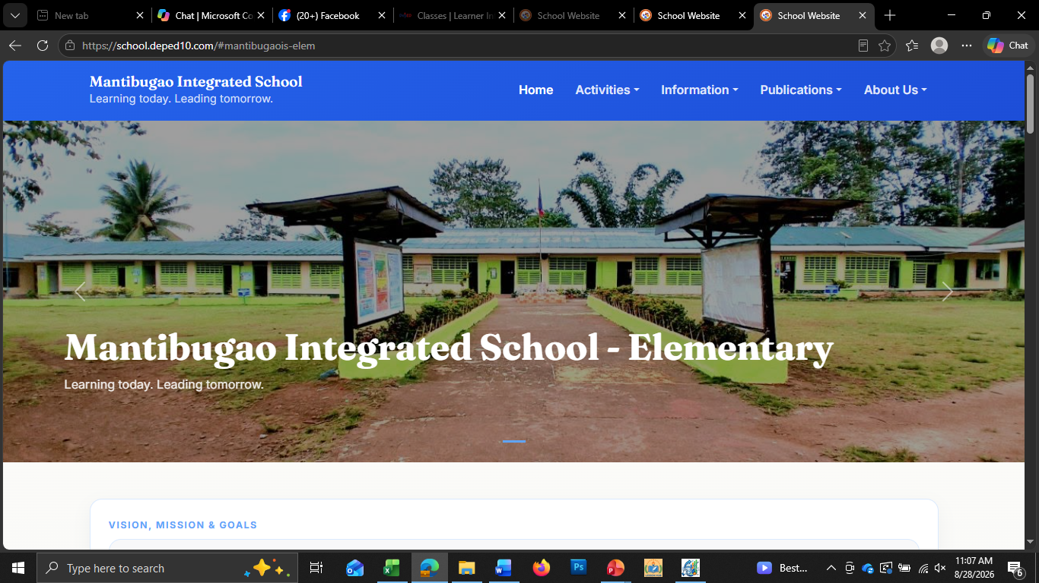
School Name: Mantibugao Integrated School
School ID: 502161
Region: Region X-Northern Mindanao
Division: Bukidnon
District: Manolo Fortich II
School Head: Dante O. Cabaron
Principal I
School Address: Zone-3, Mantibugao, Manolo Fortich, Bukidnon
Year Established: 1954
SCHOOL PROFILE
No. of Learners Enrolled | 736
No. of Teachers | 25
Learner-teacher Ratio | 30:1
No. of Classrooms | 14
No. of Makeshift | 4
Classroom-learner Ratio | 1:30

Slide 3
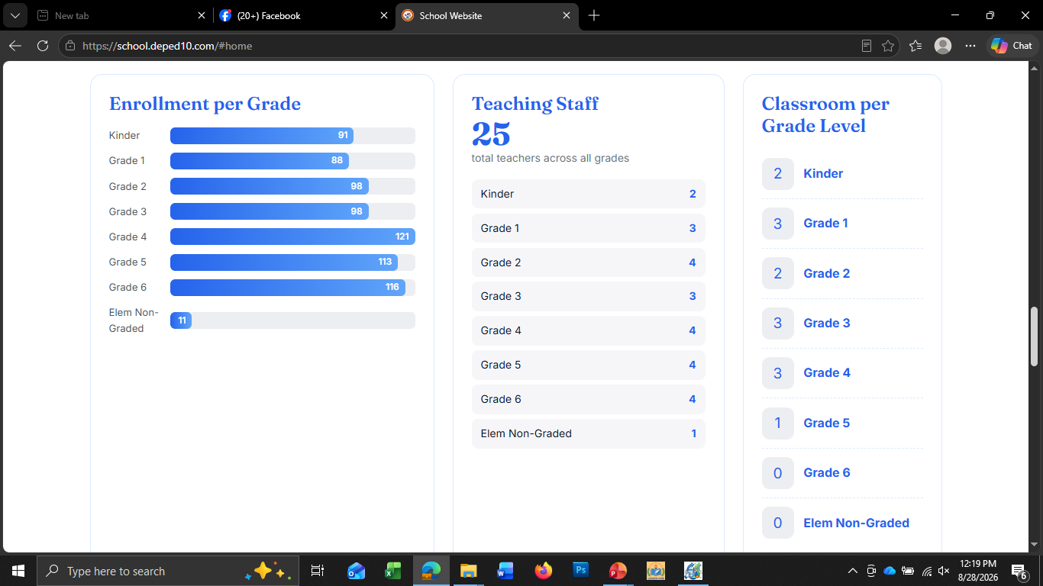
Teacher: Learner Situation
Note: Please take a screenshot of this slide as it appears on your school’s official website. Do not create or prepare your own dashboard. Please remember that the enrollment data reflected in the RLF-RAPID must exactly match the enrollment data reported in the Department of Education’s Learner Information System (LIS). Ensure that the figures are accurate, consistent, and based on the official LIS data.
 | Kinder | Grade 1 | Grade 2 | Grade 3 | Grade 4 | Grade 5 | Grade 6 | SNED
Teaching Staff | 2 | 3 | 4 | 3 | 4 | 4 | 4 | 1
Enrollment | 91 | 88 | 98 | 98 | 121 | 113 | 116 | 11

Slide 4
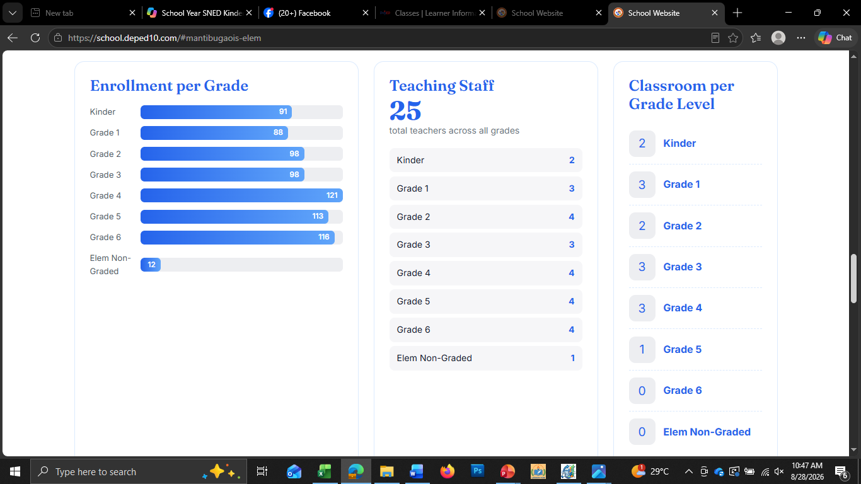
Classroom: Learner Situation
Elementary (SY 2026-2027)
Note: Please take a screenshot of this slide as it appears on your school’s official website. Do not create or prepare your own dashboard.Please ensure that the enrollment and classroom data reflected in the RLF-RAPID exactly match the official data reported in the Department of Education’s Learner Information System (LIS) and National School Building Inventory (NSBI), respectively.
All figures must be accurate, consistent, and based strictly on the latest official LIS and NSBI data. Please verify the data carefully before submitting the screenshot.
 | Kinder | Grade 1 | Grade 2 | Grade 3 | Grade 4 | Grade 5 | Grade 6 | Non-Graded
Classroom | 2 | 3 | 2 | 3 | 3 | 1 | 0 | 0
Enrollment | 90 | 88 | 107 | 98 | 121 | 112 | 116 | 11

Slide 5
Budget Utilization (Obligation & Disbursement)

Slide 6
Budget Utilization (Obligation & Disbursement)
SECOND QUARTER
MOOE MANTIBUGAO INTEGRATED SCHOOL | ALLOCATION | P230,768.11
 | LIQUIDATED | P227,622.22
 | BALANCE FOWARDED | P3,245.89

Slide 7

Learners at Risk of Dropping Out
Elementary (SY 2026-2027)
13
1. What programs, interventions, or initiatives have been implemented in your school to prevent and reduce learner dropouts?
2. If the school has a high number of Learners at Risk of Dropping Out:
What are the key limitations, gaps, or challenges affecting the effectiveness of these programs?
Which programs or interventions need to be strengthened, improved, or redesigned?
What additional support or resources are needed to make these interventions more effective?
3. If the school has zero or very few Learners at Risk of Dropping Out:
What are the key factors or elements that contributed to the success of your dropout-prevention programs?
What best practices, strategies, or interventions have worked particularly well?
Which of these practices can be sustained, replicated, or adopted by other schools?

Slide 8
What programs, interventions, or initiatives have been implemented in your school to prevent and reduce learner dropouts?
Project KEEPS (Keeping Every Elementary Pupil in School) To reduce the occurrence of learners drop- Outs and irregular attendance due to family related concerns, less parental monitoring and academic and behavioral difficulties
Project AAKAY (Alalay sa Kabataan para sa Aral at Yaman)To reduce the number of school leavers
Project ACCESS ( Addressing Distance Constraints, Child Labor Involvement, and Caretaking Duties among Learners) Hatid- sundo ng mga mag-aaral na nasa malayo Barangay assisted transportation of learners, commitment to parents and provision of learning packets

Slide 9
2. If the school has a high number of Learners at Risk of Dropping Out:
What are the key limitations, gaps, or challenges affecting the effectiveness of these programs?
Which programs or interventions need to be strengthened, improved, or redesigned?
What additional support or resources are needed to make these interventions more effective?
Monitoring systems
Limited teacher capacity
Low parental involvement
Socio-economic barriers

Slide 10
Learners at Risk of Dropping Out
Secondary (SY 2026-2027)
13
1. What programs, interventions, or initiatives have been implemented in your school to prevent and reduce learner at risk of dropping out?
2. If the school has a high number of learner at risk of dropping out :
What are the key limitations, gaps, or challenges affecting the effectiveness of these programs?
Which programs or interventions need to be strengthened, improved, or redesigned?
What additional support or resources are needed to make these interventions more effective?
3. If the school has zero or very few learner at risk of dropping out :
What are the key factors or elements that contributed to the success of your dropout-prevention programs?
What best practices, strategies, or interventions have worked particularly well?
Which of these practices can be sustained, replicated, or adopted by other schools?

Slide 11
Remember:
Criteria for Identifying Learners at Risk of Dropping Out (LARDO)
Attendance | Frequent absences; habitual tardiness; prolonged non-attendance; repeated unexplained absences; learner has accumulated absences approaching the allowable limit.
Academic Performance | Consistently low grades; multiple learning competencies not mastered; repeated failure in subjects; declining academic performance.
Behavioral Indicators | Poor classroom participation; repeated disciplinary concerns; disengagement from learning; refusal to participate in school activities.
Family Circumstances | Parents working away from home; lack of parental supervision; family conflict; orphaned learner; child under guardianship; frequent relocation.
Economic Situation | Poverty; inability to purchase school supplies; learner engaged in child labor; irregular attendance due to work; transportation difficulties.

Slide 12
Remember:
Criteria for Identifying Learners at Risk of Dropping Out (LARDO)
Health Condition | Chronic illness; disability without adequate support; malnutrition; mental health concerns affecting attendance or participation.
Environmental Factors | Residence in geographically isolated areas; disaster-affected communities; conflict-affected areas; unsafe route to school.
Child Protection Concerns | Abuse, neglect, exploitation, bullying, violence, or other protection issues affecting school participation.
Enrollment / Participation | Learner repeatedly absent during the opening weeks of classes; difficult to contact despite school interventions; at risk of becoming No Longer Participating in Learning Activities (NLPA).

Slide 13
Students’ Physical and Mental Well-being
CHILD PROTECTION COMMITTEE (CPC)
Chairperson | Dante O. Cabaron
Vice-Chairperson | Luzviminda M. Cabungcal
Members: | Helinita A. Raterta
 | Jonathan M. Talmag
 | Anthony E. Pailagao
 | Hon. Liza G. Carangcarang

Slide 14
Students’ Physical and Mental Well-being
SCHOOL GOVERNING COUNCIL (SGC)
Chairperson | Dante O. Cabaron
Vice-Chairperson | John Paul Labasano
Secretary | Jeazel M. Ching
Members: | Lilibeth O. Amboy
 | Maricel U. Huera
 | Aleja D. Martinez
 | Helinita A. Raterta
 | Liza G. Carangcarang
 | Ecyl Valmoria
 | Kathleen Amboy

Slide 15
Issues and Concerns
 |  |  | Action Taken or to be taken
Operational Issue | Policy Issue | Technical Assistance Needed from the Division Office and recommendations
Literacy and numeracy instructional struggle form grade 1-6 | Lack of standardized intervention for struggling issues and numeracy learners at the school level. Limited access to trained teachers, and insufficient learning materials, which hinder early skill development. | Teacher training Instructional materials Monitoring and evaluation Intervention programs Mentoring and coaching | Conduct of regular reading and numeracy remediation sessions; implementation of Project DEAR (Drop Everything and Read) and math drills during homeroom periods
High incidence of absenteeism among learners affecting participation rate and learning continuity | Policies that strengthen attendance monitoring, provide support systems for at-risk learners, and engage families to ensure consistent school attendance. | Capacity-building workshops Parent and community engagement | Implementation of home visitation program; regular monitoring of attendance; coordination with parents and barangay officials
Insufficient number of classrooms and dilapidated classrooms | Policies must also allocate funds for the rehabilitation of dilapidated classrooms, establish public-private partnerships and community-driven initiatives. | Partnership facilitation | Submitted requests and reports on classroom needs; conducted minor repairs using available resources; coordinated with stakeholders for support; prepare and submit proposals for classroom construction and rehabilitation; continue advocating for inclusion in infrastructure funding programs.

Slide 16
Catch-up Plan
Physical Target (Backlog) | Under/Over Achievement (Physical) | Action Plan | Person-in-Charge | Target date of Completion
100% of struggling readers and numeracy learners (Grades 1–6) identified and enrolled in intervention program | Under — only 70% of targeted learners have completed remediation sessions for Q2 | Intensify reading and numeracy remediation sessions; conduct after-class tutorials and learning camps; administer PHIL-IRI and CRLA post-assessment to measure progress | Class Advisers, Reading Coordinator, School Head | End of 2nd Trimester, SY 2026–2027
Reduce absenteeism rate to below 5% by end of the school year | Under — current absenteeism rate remains above the target threshold for Q2 | Conduct home visitation for habitually absent learners; strengthen parent engagement through regular PTA meetings; coordinate with barangay officials for community monitoring | Guidance Teacher, Class Advisers, PTA Officers | End of 2nd Trimester, SY 2026–2027
Construction of 2 additional classrooms to address classroom shortage and improve learning conditions. | Target not achieved due to insufficient funding and non-inclusion in the current year's infrastructure allocation, resulting in continued classroom shortages and overcrowding. | Prepare and submit classroom construction proposals; coordinate with the Division Office, LGU, and other stakeholders for funding support; advocate for inclusion in priority school building programs; utilize temporary learning spaces while awaiting construction. | School Head, School Planning Team, District Engineer/Property Custodian, SGOD/School Facilities Coordinator | End of School Year 2026–2027 or upon approval and release of funds.

Slide 17
Thank you!

